Slide 1

Unloading the Theological Truck
1:1 – 14
Introduction and Overview
Week 15
27 April 2022

Slide 2
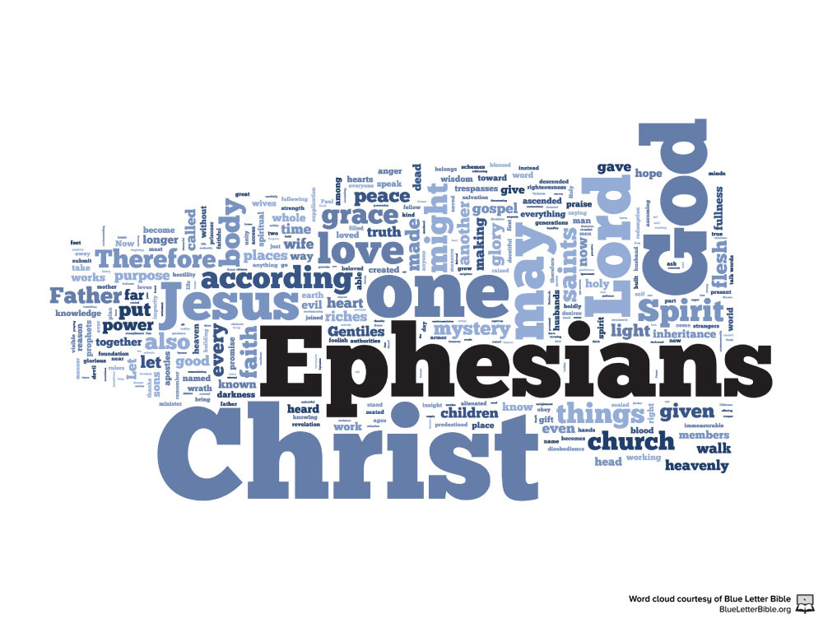

Slide 3
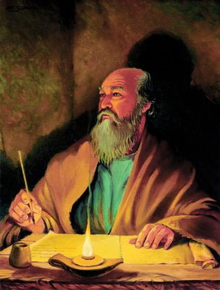
The Apostle Paul at his writing desk

Slide 4
NEW TESTAMENT
GOSPELS
Galatians
Galatians
Hebrews
Matthew
Ephesians
GENERAL EPISTLES
Ephesians
Philippians
Mark
Philippians
James
Luke
Colossians
Colossians
1 Peter
John
1 Thessalonians
2 Peter
Acts
2 Thessalonians
1 John
PAUL’S EPISTLES
1 Timothy
2 John
Romans
2 Timothy
3 John
Romans
1 Corinthians
Titus
Jude
1 Corinthians
2 Corinthians
Philemon
REVELATION
Notes:
In Slide Show mode click on any option above to be taken to the book or section of the Bible.

Slide 5
INTRODUCTION
and
OVERVIEW

Slide 6

The Pauline Epistles
First Missionary Journey:
Galatians (ad 48-49)
Second Missionary Journey:
1 Thessalonians (ad 50-52)
2 Thessalonians (ad 50-52)
Third Missionary Journey:
1 Corinthians (ad 55-56)
2 Corinthians (ad 56)
Romans (ad 57)

Slide 7
The Pauline Epistles
First Roman Imprisonment:
Ephesians (ad 60)
Philippians (ad 62)
Colossians (ad 62)
Philemon (ad 62)
While in Macedonia
1 Timothy (ad 63 – 66)
Titus (ad 63 – 66)
Second Roman Imprisonment:
2 Timothy (ad 67)
Hebrews (ad 68 – 69)

Slide 8
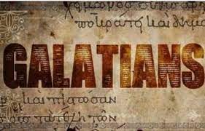
An Introduction

Slide 9
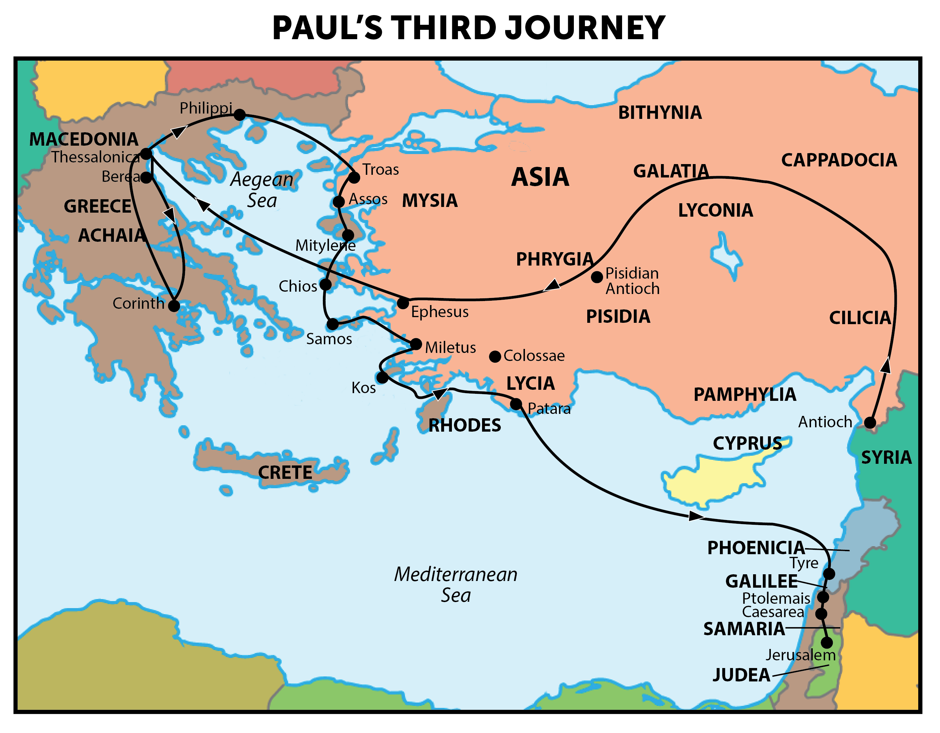
Paul’s Third Missionary Journey A.D. 54 – 58

Slide 10
Ephesians
Who: Paul
What: Letter to the Church in Ephesus
Where: Prison in Rome
When: c. ad 60 – 62
Why: To show believers what it means to be a follower of Christ and encourage them in their spiritual walk.
Synopsis: Christians are all members of Jesus’ “body,” the Church.

Slide 11
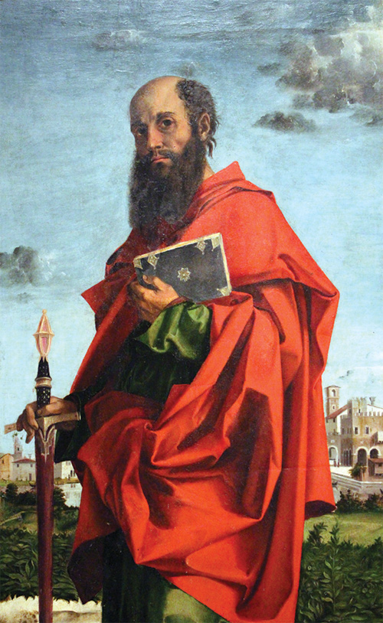
Ephesians
Outline (Chapter):
Spiritual Blessings: The calling of the church (1 – 3)
The Christian Life: The conduct of the church (4 – 6)
Apostle Paul

Slide 12
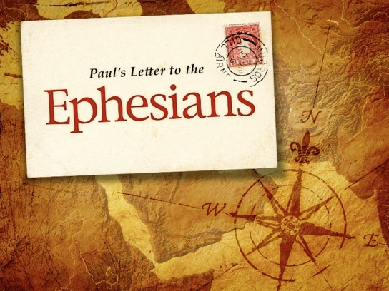
Overview

Slide 13
Ephesians overview
Paul had started the church in Ephesus (Acts 19) and now explains in detail the church members’ relationship to Jesus Christ – so that they “may grow up into him in all things, which is the head, even Christ” (4:15).
Through Jesus, God has reconciled both Jews and Gentiles to Himself (2:11-18). This new life should result in pure, honest living in the church and in the home (Ch 4-6).
Ephesians was written from Rome and is the first in order of four Prison Epistles (Philippians, Colossians, and Philemon). Paul was forbidden by the Holy Spirit to enter Asia, where Ephesus was the center (Acts 16:6)

Slide 14
Ephesians overview
On his second missionary journey, Paul visited Ephesus and left Aquila and Priscilla there (Acts 18). He returned to Ephesus two years later and ministered for three years, reaching the whole province of Asia with the gospel (Acts 19).
Some years later when Paul was a prisoner in Rome (A.D. 60-62), Paul wrote this letter to the believers in Ephesus. Unlike other epistles written to specific churches, this epistle does not deal with specific problems in a local congregation. Instead, Paul addressed great themes that pertain to the Christian's position in Christ, as a member of the body of Christ, the church.

Slide 15
Ephesians overview
One major theme of Ephesians in that God is at work in this world, through His church, putting things together. As expressed in his prayer for his readers, it was his desire that they might know:
What is the hope of God's calling (1:18).
What are the glorious riches of God’s inheritance in the saints (1:18).
What is God's great power toward those who believe (1:19).
To remind Christians of their spiritual blessings in Christ (1:3).
To exhort Christians to have a “walk” worthy of the calling with which you were called (4:1).

Slide 16
Ephesians overview
In the first three chapters, Paul explains this as a work of redemption (Ch 1), resurrection (2:1-10), and reconciliation (2:11–3:21). In chapter 4-6, Paul states the responsibilities of believers in the light of God’s great purpose. Note the emphasis on the word “walk.”
Ephesus was an important city and boasted of being custodian of the Temple of Diana, one of the seven wonders of the ancient world. The city was devoted to idolatry, which explains why Paul had so much to say about defeating the devil (6:10ff).
The Ephesian letter shows the balance in the Christian life between doctrine (Ch 1-3) and duty (Ch 4-6), divine sovereignty and human responsibility.

Slide 17
Ephesians overview
We do not obey God so that He will give us His grace; we obey Him in response to grace already given.
Paul was called by a vision to Macedonia. He was led by the Spirit into Europe as far a Corinth, after which he returned by way of Ephesus (Acts 18:19).
Paul was so impressed that he promised to return and he did on his third missionary journey. He stayed there two years – longer than at any other place (Acts 19:8-10).

Slide 18

Ephesians 1:3

Slide 19

Ephesians 2:8-9

Slide 20

Ephesians 2:22

Slide 21
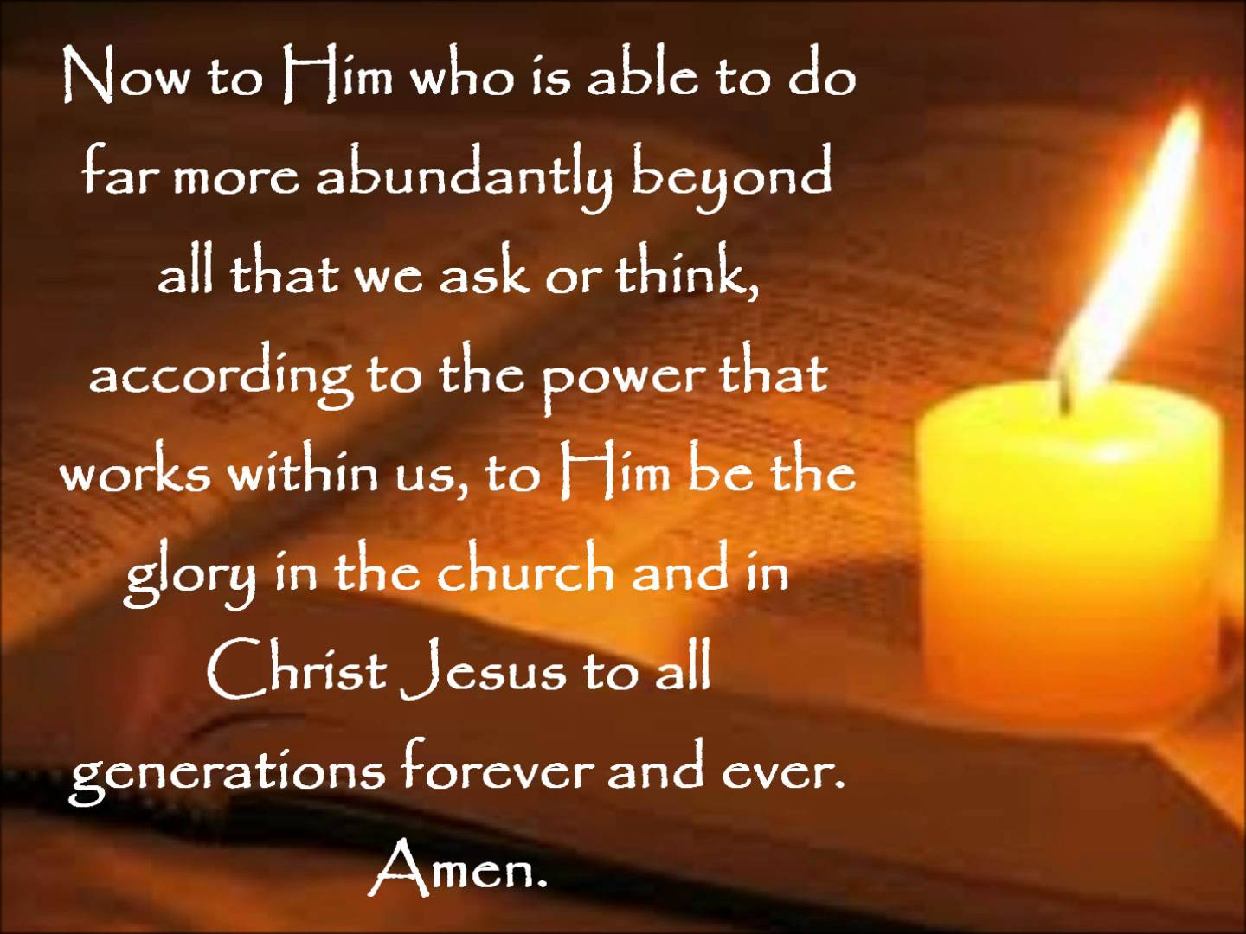
Ephesians 3:20

Slide 22
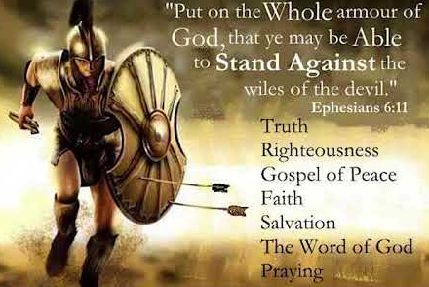
Ephesians 6:11

Slide 23
Unloading the Theological Truck

Slide 24
Ephesians 1:1 – 2
¹Paul, an apostle of Christ Jesus by the will of God,
To God’s holy people in Ephesus, the faithful in Christ Jesus: ²Grace and peace to you from God our Father and the Lord Jesus Christ.

Slide 25
Ephesians 1:1 – 2
It takes a man whose life has been changed to write a life-changing letter. The apostle Paul certainly qualifies. Saul of Tarsus grew up in a fundamentalist Jewish household. He lived in strict accordance with the Law up through his young-adult years. In fact, when the time came for his schooling, Saul left Tarsus and traveled to Jerusalem in order to study under the most renowned rabbi of the sect of the Pharisees—Gamaliel (Acts 22:3).
Yet God had others plans for this rising star of Judaism. Soul no doubt intended to utilize his brilliant intellect, stellar reputation, and strong leadership skills to promote the Law. Then Jesus Christ altered his plans, stopped him in his tracks as he sought to persecute the church of God (Acts 9:3-5).

Slide 26
Ephesians 1:1 – 2
At that moment, Saul of Tarsus “died” on the road to Damascus, where he had been sent by the Jewish leaders to destroy the church in that ancient city. Simultaneously, God raised him to a new life, sending him instead to build up the church of Christ worldwide.
As Paul the apostle—a word meaning “sent one”—this Jewish-Pharisee-turned-Christian-missionary was entrusted with the saving gospel of Jesus Christ for the nations. So, as Paul the apostle pens the opening lines of his letter to the Ephesians, he reflects on the theological depths of the gospel. He unloads truths about God’s sovereignty and grace that he not only knew to be true but also had personally experienced in his own conversion.

Slide 27
Ephesians 1:1 – 2
Paul was made an apostle of Christ Jesus through God’s will or decision. It was not his own choosing or plan. Thus he had God’s authority behind him. As an apostle Paul was commissioned and sent by God with the gospel message.
The letter is addressed to the saints who resided in Ephesus. “Saints” (“holy ones”) are those set apart for God’s use. They are a part of the universal church by virtue of their salvation in Christ. The faithful in Christ Jesus further defines the “saints” and could be rendered “that is, the believers in Christ Jesus.” These saints were in Christ Jesus, not in Adam or the goddess Artemis of Ephesus. Christians have their very life in Christ (1:1).

Slide 28
Ephesians 1:1 – 2
After identifying himself and his audience, Paul uses his standard greeting of grace and peace from both God the Father and the Lord Jesus Christ (1:2). In this letter, Paul will develop these two theme in depth.
Grace—which expresses God’s steadfast love toward man—will be in the spotlight throughout the first three chapters as Paul describes God’s favor toward undeserving sinner. Grace is the gift of salvation given freely to those who believe.
And the reality of peace with God and fellow believers in Jesus Christ will figure prominently in chapter 2.

Slide 29
Ephesians 1:3 – 6
³Praise [blessed] be to the God and Father of our Lord Jesus Christ, who has blessed us in the heavenly realms with every spiritual blessing in Christ. ⁴For he chose us in him before the creation of the world to be holy and blameless in his sight. In love ⁵he predestined us for adoption to sonship through Jesus Christ, in accordance with his pleasure and will — ⁶to the praise of his glorious grace, which he has freely given us in the One he loves.

Slide 30
Ephesians 1:3 – 6
Paul uses the word “blessed” [or “praise”] three times in the in all of the Ephesian letter—all in a single verse (1:3). Thus Paul sets in motion a beautiful and deep litany of praise to his triune God, which extends to the end of 1:14.
Interspersed throughout this concert of praise, three resounding doxologies, or praises of God’s glory, emerge. In Paul’s mind, everything God does is for His own glory and honor. Theologians call this the “doxological purpose” of God’s plan.
Note that each of the three doxologies in Ephesians 1:6, 1:12, and 1:14 relates to the work of a distinct member of the Godhead—the Father, the Son, or the Holy Spirit.

Slide 31


Slide 32
Ephesians 1:3 – 6
The Father: “He predestined us to adoption as sons through Jesus Christ to Himself, according to the kind intention of His will, to the praise of the glory of His grace, which He freely bestowed on us in the Beloved” (1:5-6).
The Son: “In [Christ] also we have obtained an inheritance, having been predestined according to His purpose who works all things after the counsel of His will, to the end that we who were the first to hope in Christ would be to the praise of His glory” (1:10-12).
The Holy Spirit: “You were sealed in Him with the Holy Spirit of promise, who is given as a pledge of our inheritance, with a view to the redemption of God’s own possession, to the praise of His glory” (1:13-14).

Slide 33
Ephesians 1:3 – 6
One can almost hear the exuberance in Paul’s tone in Ephesians 1:3-14 as he focuses all attention upward, blessing the triune God, who has blessed us in so many ways. In fact, in this passage of praise, Paul mentions at least ten reason to praise the triune God. Let’s closely examine each of them.
FIRST – we praise God because He blessed us with every spiritual blessing (1:3). God’s “good word” of blessing toward us is infinitely more than the mere “bless you” we throw around when somebody sneezes. The word from God’s mouth does not return empty, but effects genuine change (Isa. 55:11).

Slide 34
Ephesians 1:3 – 6
FIRST – we praise God because He blessed us with every spiritual blessing (cont.). In Paul’s hymn of praise, he specifically has in mind “spiritual” blessings—benefits already bestowed upon believers because of their intimate association with the Savior, Jesus Christ (1:3). Such blessings, sealed by Christ and reserved in heaven, can ner be taken away.
SECOND – we praise God because He chose us (1:4). Paul says that God chose us in Jesus Christ “before the foundation of the world.” Before anything existed, we were on His mind. Before earth was created, before Adam and Eve were formed, before the fall of humanity occurred, God had already preordained that we would be “holy and blameless” in His presence (1:4).

Slide 35
Ephesians 1:3 – 6
SECOND – we praise God because He chose us (cont.). Paul’s purpose is not only that we should believe this profound truth and praise God for it but also that we should “walk in a manner worthy of the calling with which you have been called” (4:1).
The fact that God has chosen us for salvation in Christ should not cause us to boast; it should drive us to humility. It should not make us live loose lives; it should motivate us to be good—that is, to conduct ourselves in holiness and blamelessness before Him (1:4).

Slide 36
Ephesians 1:3 – 6
THIRD – we praise God because He adopted us (1:5-6). The Greek term “to predestine,” means “to foreordain” or “to determine in advance.” To what, though, did God predestine believers? To adoption as sons through Jesus Christ (1:5). Under Roman law, which served as a backdrop for Paul’s writing, adopted children enjoyed precisely the same rights and privileges as natural children.
Think of it! Like penniless paupers rescued from the slums and adopted into a king’s family, we have been adopted into the family of God. When were we adopted into God’s family? The moment we believed. From that point on, we became heirs of all the promises as children of God—eternal life, fellowship with the Father, the promise of resurrection, the reward of reigning with Christ.

Slide 37
Ephesians 1:3 – 6
THIRD – we praise God because He adopted us (cont.). Could we have resisted and walked away? Not if we were chosen. God’s irresistible working in our lives guaranteed the fulfillment of His sovereign plan for us. Not because we’re special or unique, or because we somehow stood out above the crowd of fallen sinner, but by His sheer mercy God chose to save us.
If God chose us, couldn’t we be adopted without believing? No, because we’re saved through faith—our personal, willing response to the gospel message. If we do not believe, the salvation provided by God is not applied to us. God’s sovereign choice in predestination and our personal responsibility to believe are two truths that run parallel to each other—two rails of the same railroad track.

Slide 38
Ephesians 1:3 – 6
THIRD – we praise God because He adopted us (cont.). Two parallel lines that never meet. If we remove one or the other, if we move them closer together, or if we separate them, the train will careen into the ditch. Both rails are essential for the truth to proceed.
From God’s limitless, heavenly perspective, everything is planned out. Since we believe in an all-powerful, all-knowing God, how could it be otherwise? However, we don’t know who will or will not believe, so our role is to share the gospel with as many people as we can and then trust God to do His convicting and saving work by His Spirit. Our sharing should be winsome and appealing, but His work is sovereign and irresistible.

Slide 39
Ephesians 1:7 – 12
⁷In him we have redemption through his blood, the forgiveness of sins, in accordance with the riches of God’s grace ⁸that he lavished on us. With all wisdom and understanding, ⁹he made known to us the mystery of his will according to his good pleasure, which he purposed in Christ, ¹⁰to be put into effect when the times reach their fulfillment—to bring unity to all things in heaven and on earth under Christ. ¹¹In him we were also chosen, having been predestined according to the plan of him who works out everything in conformity with the purpose of his will, ¹²in order that we, who were the first to put our hope in Christ, might be for the praise of his glory.

Slide 40
Ephesians 1:7 – 12
Ephesians 1:7 makes a seamless transition from the work of God the Father to the work of God the Son, through whom God implemented His plan. Here Paul includes five more reasons to give God our praise.
FOURTH – we praise God because He redeemed us (1:7). The word redemption describes the act of purchasing from bondage by paying a price. That is, the purchasing from bondage in order to release one from his or her former compulsions and servitude. God has redeemed believers, setting them from the shackles of sin. In order to do so, however, a price had to be paid. How did He do it? Not with silver or gold, but with the precious blood of His own Son, Jesus Christ (1Peter 1:18-19).

Slide 41
Ephesians 1:7 – 12
FIFTH – we praise God because He forgave us (1:7). Not only redeemed, but our debt has been canceled by the infinite riches of His grace. This means that He no longer holds any of our transgressions against us—past, present, or future. As the psalmist says, “As far as the east is from the west, so far has He removed our transgressions from us” (Ps. 103:12).
Paul uses the word “trespass,” which indicates taking a false step or crossing the line—think of someone walking off the right path and trampling on forbidden land. But even though “all of us like sheep have gone astray, each of us has turned to his own way” (Isa 53:6), God has placed all of our iniquities upon Christ, by whose death on the cross He forgave us of all our sins.

Slide 42
Ephesians 1:7 – 12
SIXTH – we praise God because He lavished His grace upon us (1:7-8). Grace means “getting something good that you don’t deserve.” The truth is, we don’t deserve anything from God except condemnation and wrath; but because God has redeemed us and forgiven us, He is now in a position to grant us blessings we haven’t earned and could never earn.
Yet not only do we receive this priceless grace, but God has “lavished” His blessings upon us, as Christ Himself promised concerning the recipients of His salvation: “I came that they may have life, and have it more abundantly” (John 10:10).

Slide 43
Ephesians 1:7 – 12
SEVENTH – we praise God because He made known the mystery of His will to us (1:8-10). The word “mystery” refers to a secret once concealed but now revealed. It refers to the truths about God’s plan of redemption that had not been clearly revealed in the OT but have now been made manifest.
Frankly, God’s plan revealed in Jesus Christ caught most religious Jews off guard. They were anticipating a great and mighty military victor who would overthrow Rome, rescue their people from all Gentile oppression, and restore the kingdom of Israel. Though the Jews had a narrow, nationalistic understanding of the scope of redemption through the Messiah, God had planned to sum up “all things in Christ,” all authority in heaven and on earth (Matt 28:18).

Slide 44
Ephesians 1:7 – 12
EIGHTH – we praise God because He provided an eternal inheritance for us (1:10-12). God has provided for believers an eternal, irrevocable inheritance grounded in His sovereign choice and predestined according to His will. Due to our position in Christ, we are joint heirs with Him. When He comes into His ultimate inheritance—His universal rule over all creation—we will reign with Him (Rev 20:6).
Those who have trusted in Christ not only receive spiritual blessing of forgiveness, reconciliation, and the indwelling Holy Spirit but also have the promise of heaven with Christ when we die (2Cor 5:1-10). When He returns, we will be raised in new, glorified bodies to share with Him an eternal inheritance on a new earth (1Thes 4:15-17).

Slide 45
Ephesians 1:13 – 14
¹³And you also were included in Christ when you heard the message of truth, the gospel of your salvation. When you believed, you were marked in him with a seal, the promised Holy Spirit, ¹⁴who is a deposit guaranteeing our inheritance until the redemption of those who are God’s possession—to the praise of his glory.

Slide 46
Ephesians 1:7 – 12
Just as the first three reasons to give God praise related to the work of God the Father, and the next five related to the blessing we have through God the Son, so the last two reasons relate to the work of God the Holy Spirit.
NINTH – we praise God because He sealed us by the Spirit (1:13). By sealing us, God marked us as His own—permanently and irreversibly. The word “seal” means “to make something secure,” and the seal itself denotes ownership, approval, or closure. That is, all those who have heard and believe—those who have placed their trust in Christ alone for salvation—have been permanently sealed. This passage support the notion of “the eternal security of believers.”

Slide 47
Ephesians 1:7 – 12
NINTH – we praise God because He sealed us by the Spirit (cont.). Clearly, all those who have believed the gospel of salvation have been sealed. The transaction is complete. The Holy Spirit Himself is the promise. Like a wedding band as a symbol of a husband’s fidelity to his wife, the Holy Spirit is the seal of God’s uncompromising faithfulness to all who believe.
TENTH – we praise God because He guaranteed our inheritance (1:14). This “pledge” refers to “the first installment with a guarantee that the rest would follow.” The “pledge,” or down payment, refers specifically to the presence of the Holy Spirit, who indwells believers.

Slide 48
Ephesians 1:7 – 12
TENTH – we praise God because He guaranteed our inheritance (cont.). We have the Spirit now, and He convicts us (John 16:8), comforts us (Acts 9:31), strengthens us to experience Christ’s powerful presence (Eph 3:16), and assures us that we are God’s children (Rom 8:16).
Even so, our current experience of the Spirit is merely a sneak preview of what’s coming. The “redemption of God’s own possession” likely refers to the time when believers will receive the fullness of our inheritance as God’s children—the resurrection and glorification of our bodies. When Christ returns, deceased believers will be raised up in new, glorified bodies, and those who are still alive will be transformed. At that time the fullness of salvation will finally come. God will honor what the Spirit has pledged.

Slide 49
Paul’s Top Ten Reasons to Give God Praise
God blessed us immensely.
God chose us unconditionally.
God adopted us adoringly.
God redeemed us graciously.
God forgave us completely.
God showed grace to us lavishly.
God revealed His mystery wisely.
God granted us an inheritance eternally.
God sealed us permanently.
God guaranteed our salvation personally.

Slide 50



Slide 51
No Bible Study
Next Week – 4 May
REVIVAL

Slide 52
NEXT CLASS – 11 May 2022
Book of Ephesians
Before next class, read the below verses in the NIV and in one other versions of the Bible, i.e., NKJV, NRSV, KJV, CEV, etc …
Chapter 1:15 – 23
“Our Prayers and Christ’s Position”

